Slide 1
FINA2204 Tutorial 5:
Swaps
Zirui Song
UWA Business School
Aug 2026

Slide 2
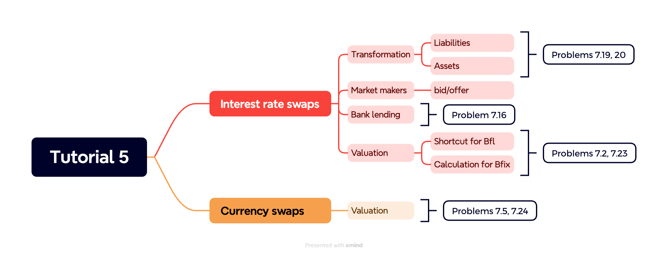
Agenda
Problem 7.2
Problem 7.5
Problem 7.16
Problem 7.19
Problem 7.20
Problem 7.23
Problem 7.24

Slide 3
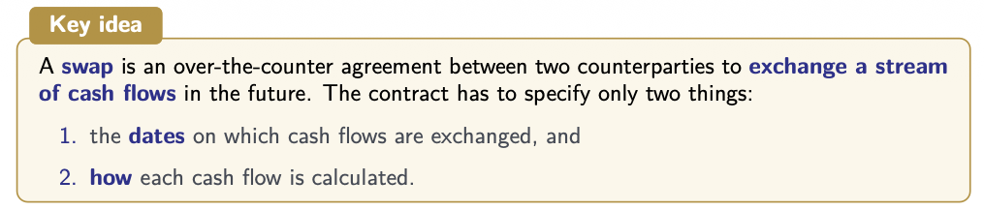
Recap: Interest rate swaps
A forward contract is essentially a swap with only one payment date.
A ‘plain vanilla’ interest rate swap is an exchange of a cash flow based on a fixed interest rate for a cash flow based on a floating reference rate (e.g., LIBOR, BBSW) for a predetermined number of years.
Notes:
playn vuh·ni·luh
lai·buh

Slide 4
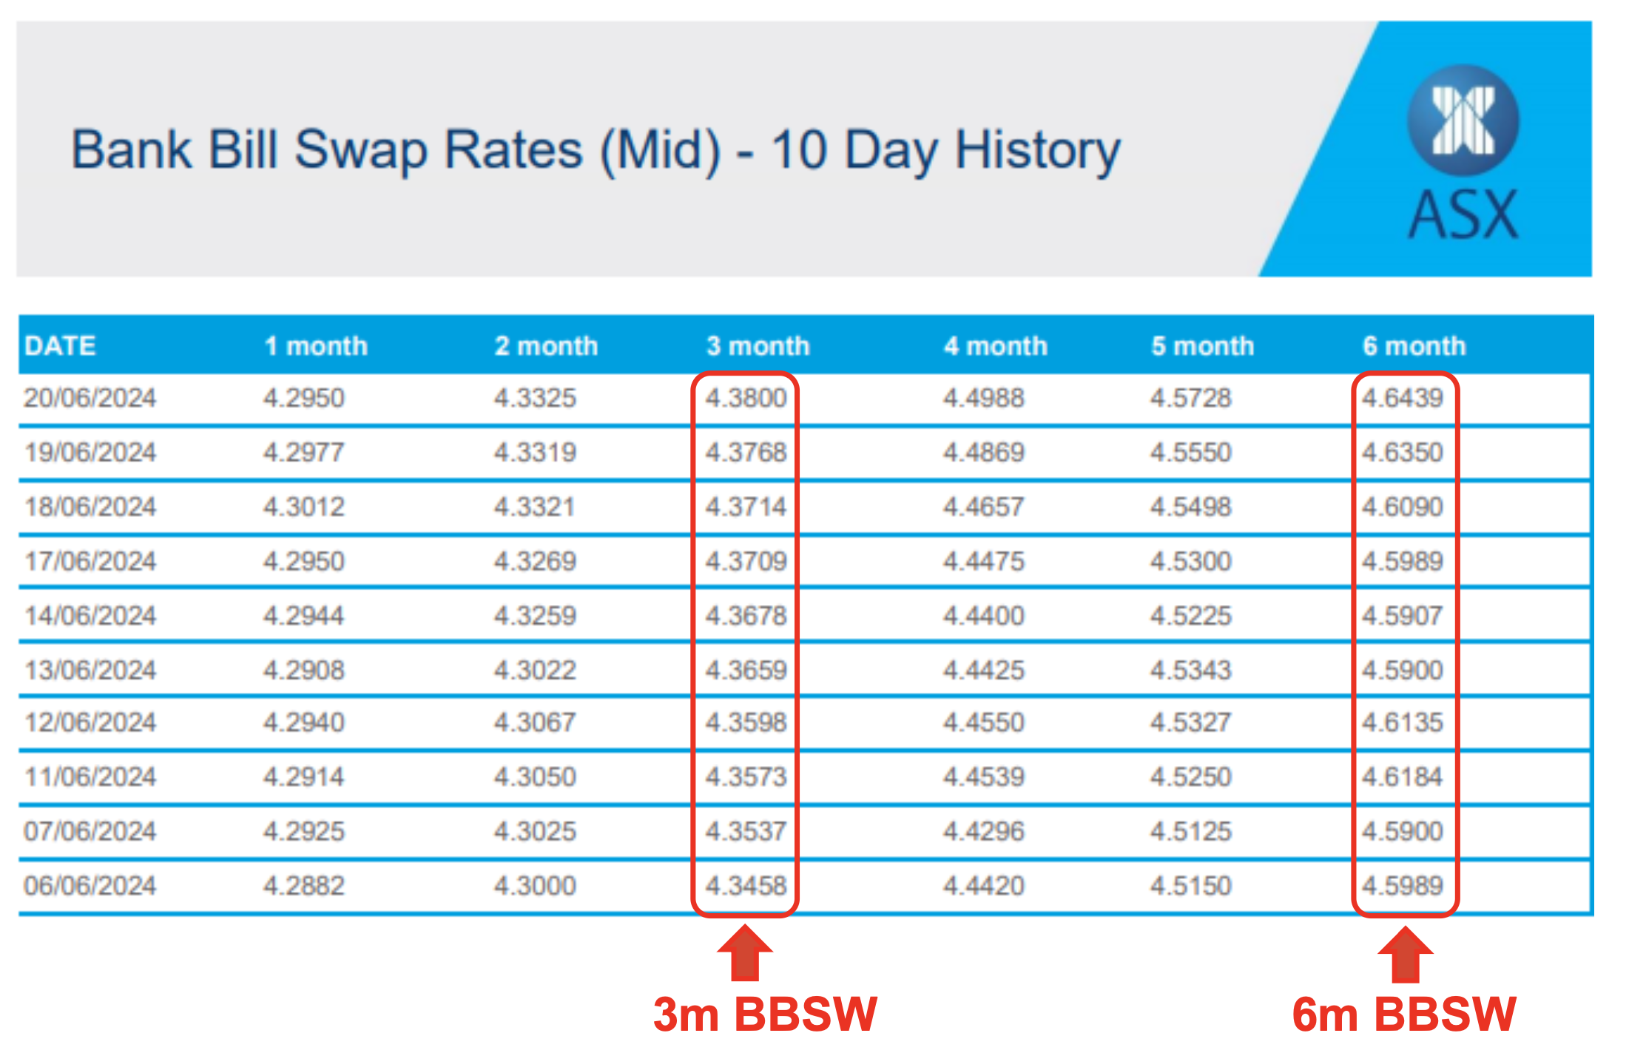
Recap: Interest rate swaps
BBSW (Bank bill swap rates) is Australia’s primary short-term benchmark interest rate.
It represents the average cost for major banks to borrow funds from one another.
Notes:
Alternatively, in Australia, we now use Bank bill swap rates (BBSW), which closely tracks the RBA’s cash rate. For example, as shown in the 10-day history from ASX, the 3m BBSW in mid-June 2024 was around 4.4%, while the 6m BBSW was slightly higher, around 4.6%, reflecting the upward term structure of Australian money market.

Slide 5
Recap: Interest rate swaps
Why use swaps?
Risk management: To switch between fixed and floating exposure as interest-rate conditions or risk preferences change.
Example: Suppose a company has floating-rate debt and is worried that interest rates will rise.
Flexibility: To reshape interest-rate exposure without refinancing the original loan.
Example: A firm uses a swap to make the effective cost of its existing floating-rate loan fixed.
Notes:
So why would a firm use a swap in the first place?
It may prefer the certainty of a fixed borrowing cost. A swap can create that fixed exposure.
Instead, the combined cash flows of the loan and the swap create the economic exposure the company wants.
It can avoid early-redemption penalties and new issuance costs.

Slide 6
Recap: Interest rate swaps
Comparative advantage: To borrow where the firm has a relative cost advantage and then swap into its preferred interest-rate structure.
Example: A company may be able to borrow relatively cheaply in the floating-rate market even though it ultimately wants fixed-rate debt.
Four basic cases
Liabilities: floating → fixed; fixed → floating
Assets: floating → fixed; fixed → floating
Notes:
But for our calculations, I want you to focus on these four basic cases.
For liabilities, we can go from floating to fixed, or fixed to floating.

Slide 7
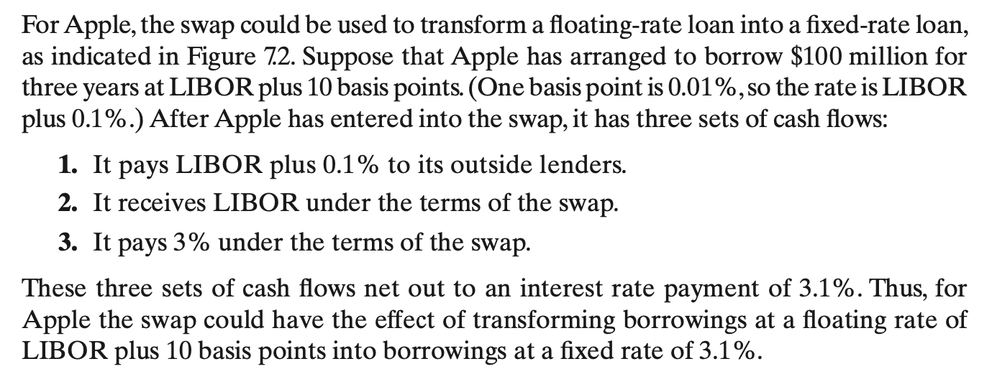
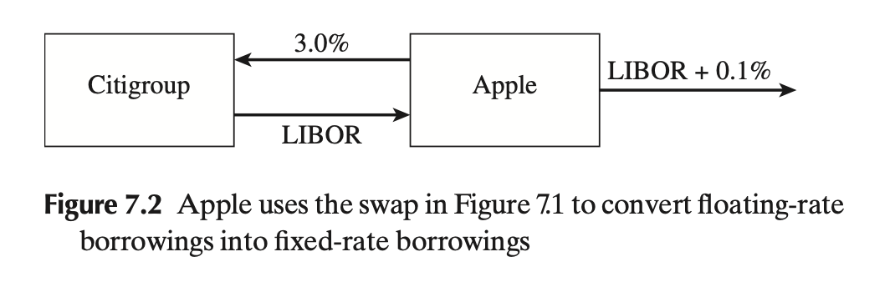
Recap: Transforming liabilities (case 1)
Liabilities: floating → fixed
floating
fixed
?
Notes:
Start with the first case: a floating-rate liability that we want to turn into fixed.
What is the unwanted part of that borrowing cost?
The LIBOR component, because LIBOR moves over time.
So if we want to remove that floating exposure, the swap should give Apple a LIBOR receipt. That receipt cancels the LIBOR Apple pays on its loan.

Slide 8
Recap: Transforming liabilities (case 1)
 | Apple
Borrowing from its outside lenders (+) | LIBOR+0.1%
Swap: Pay Citigroup (+) | 3.0%
Receive from Citigroup (-) | LIBOR
Net cost of borrowing | 3.1% =[(LIBOR+0.1%)+3.0%-(LIBOR)]
Notes:
Now let’s combine the cash flows.
The two LIBOR terms cancel.
So the underlying loan has not changed at all. It is still legally a floating-rate loan. But economically, after adding the swap, Apple has created a fixed borrowing cost of 3.1%.

Slide 9
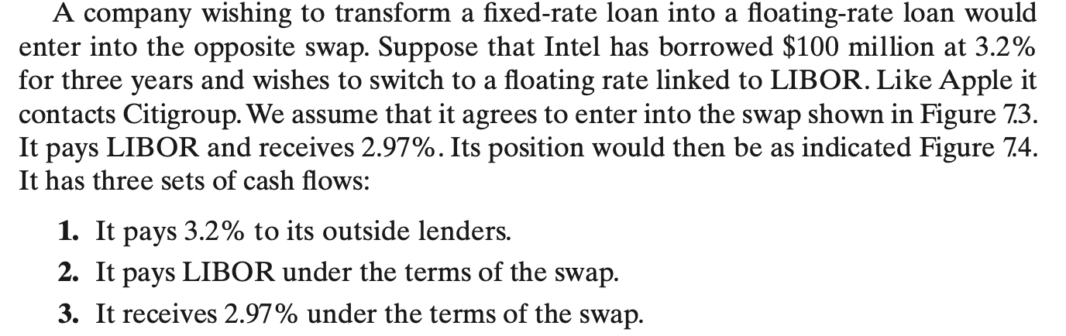
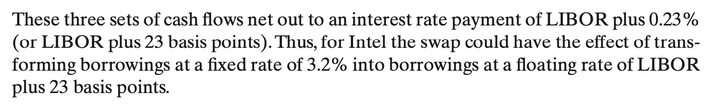
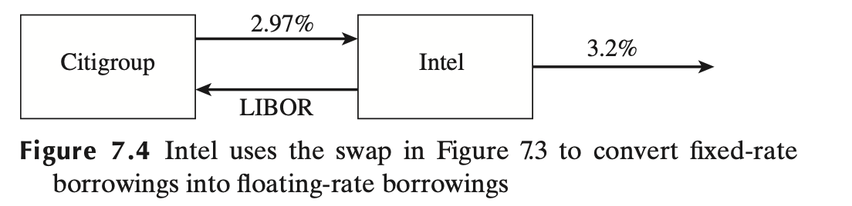
Recap: Transforming liabilities (case 2)
Liabilities: fixed → floating
 | Intel
Borrowing from its outside lenders (+) | 3.2%
Swap: Pay Citigroup (+) | LIBOR
Receive from Citigroup (-) | 2.97%
Net cost of borrowing | LIBOR+0.23% =(3.2%+LIBOR-2.97%)
Notes:
Now reverse the situation.
The unwanted cash flow is now the fixed 3.2%.

Slide 10
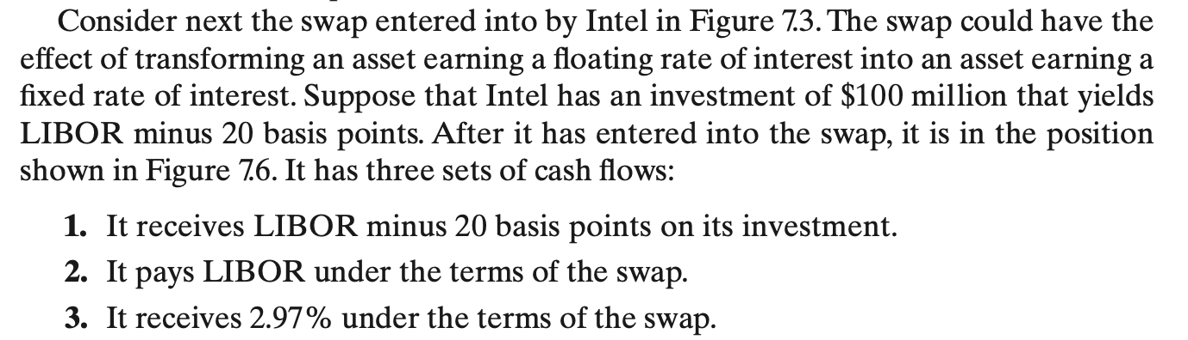
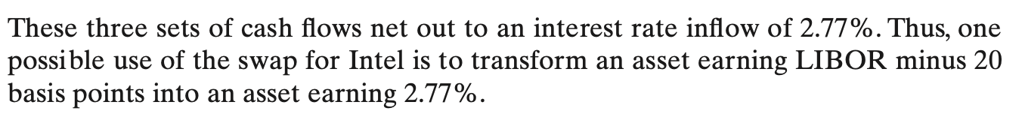
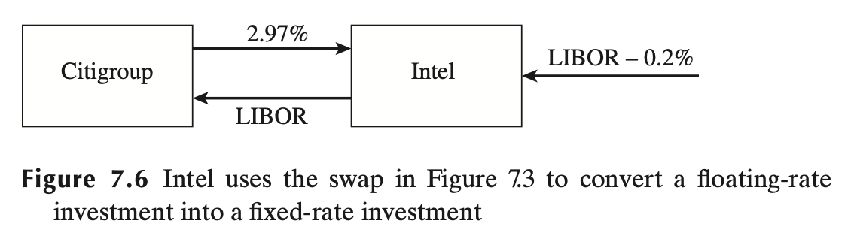
Recap: Transforming assets (case 3)
Assets: floating → fixed
Notes:
Now, let’s switch from liabilities to assets.

Slide 11
Recap: Transforming assets (case 3)
 | Intel
Return from its investment (+) | LIBOR-0.2%
Swap: Pay Citigroup (-) | LIBOR
Receive from Citigroup (+) | 2.97%
Net return of investment | 2.77% =[(LIBOR-0.2%)-LIBOR+2.97%]
Notes:
Let’s put the cash flows together.

Slide 12
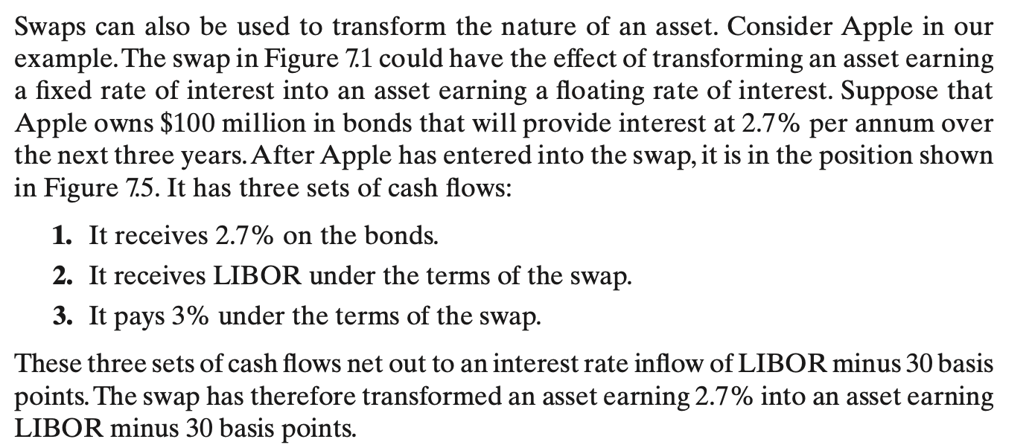
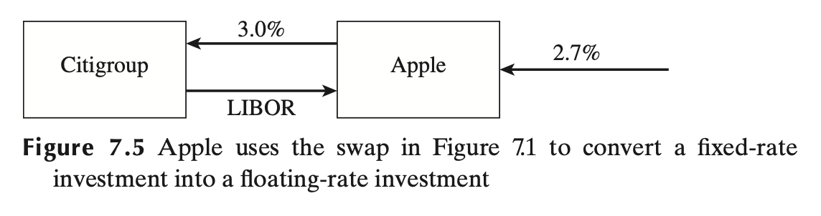
Recap: Transforming assets (case 4)
Assets: fixed→ floating
Notes:
And now the final of our four cases.

Slide 13
Recap: Transforming assets (case 4)
 | Intel
Return from its investment (+) | 2.7%
Swap: Pay Citigroup (-) | 3%
Receive from Citigroup (+) | LIBOR
Net return of investment | LIBOR-0.3% =(2.7%-3%+LIBOR)

Slide 14
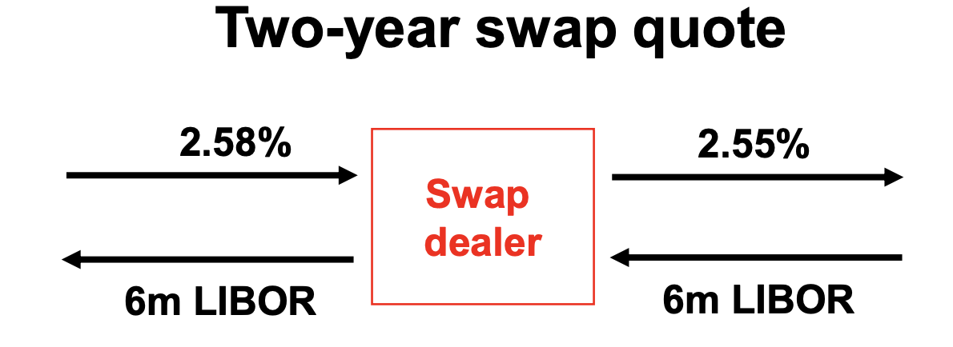
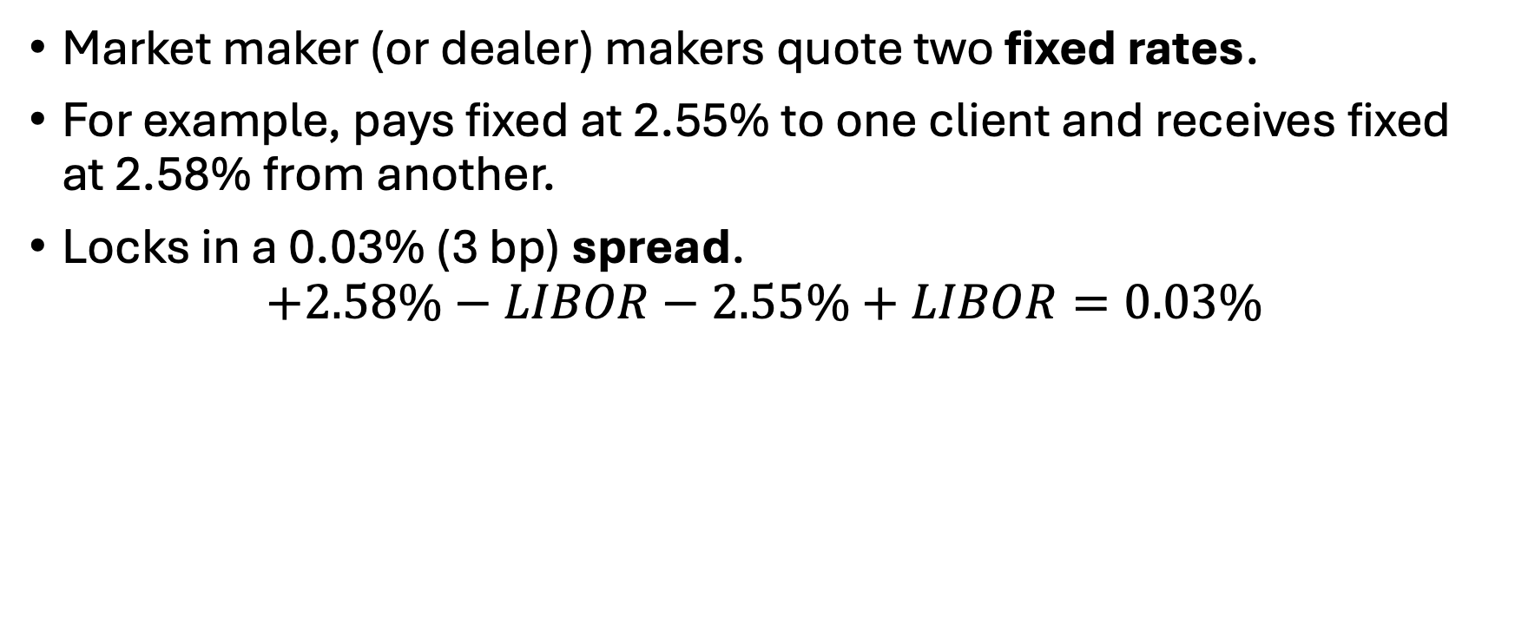
Recap: Market makers
Market maker (or dealer) makers quote two fixed rates.
For example, pays fixed at 2.55% to one client and receives fixed at 2.58% from another.
Locks in a 0.03% (3 bp) spread.
$$+2.58\%−LIBOR−2.55\%+LIBOR=0.03\%$$
Offer
Bid
Notes:
So from the dealer’s perspective, there is a spread.
The dealer pays the lower fixed rate and receives the higher fixed rate.

Slide 15
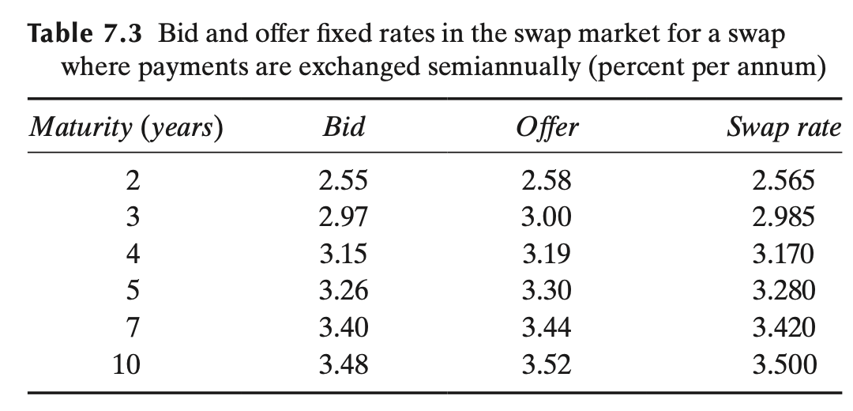

Recap: Market makers
Dealers receive high and pay low on fixed rate!
Bid: The fixed rate the dealer is willing to pay if the counterparty wants to receive fixed and pay floating.
Offer (Ask): The fixed rate the dealer is willing to receive if the counterparty wants to pay fixed and receive floating.
(Average bid-offer rate)
$$=\frac{bid+offer}{2}$$
The actual quotes used when entering into a swap contract with a dealer.
Benchmark rate for valuing swaps, constructing swap yield curve, and as a market reference.
Notes:
Let’s make the terminology precise.

Slide 16
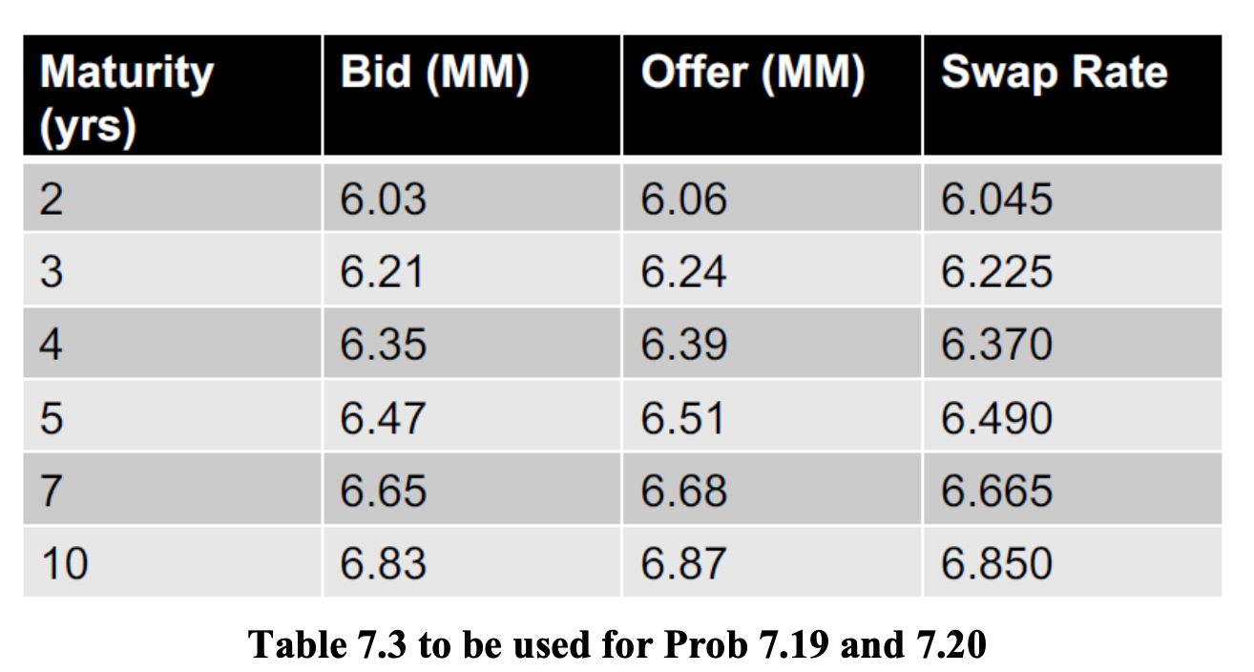
Problem 7.19
(a) Company A has been offered the rates shown in Table 7.3. It can borrow for three years at 6.45%. What floating rate can it swap this fixed rate into?
Liabilities: fixed→ floating
The dealer is fixed payer, so we use the lower three-year quote.
Notes:
To remove the fixed exposure, Company A needs to receive fixed and pay BBSW under the swap.
Now think from the dealer’s perspective.
If Company A receives fixed, the dealer is paying fixed.
And when the dealer pays fixed, which quote do we use?
The bid, the lower quote.
So we now know exactly which swap to enter.

Slide 17
Answer 7.19
Company A can pay BBSW and receive 6.21% for three years. It can therefore transform a loan at 6.45% into a loan at BBSW plus 0.24% or BBSW plus 24 basis points.
 | Company A
Borrowing from its outside lenders (+) | 6.45%
Swap: Pay dealer (+) | BBSW
Receive from dealer (-) | 6.21%
Net cost of borrowing | BBSW+0.24% =(6.45%+BBSW-6.21%)

Slide 18
Problem 7.19
(b) Company B has been offered the rates shown in Table 7.3. It can borrow for five years at BBSW plus 75 basis points. What fixed rate can it swap this floating rate into?
Liabilities: floating→ fixed
The dealer is fixed receiver, so we use the higher five-year quote.
Notes:
Now Company B has the opposite problem.
It is already borrowing at BBSW plus 75 basis points, and wants to turn that floating liability into fixed.
So we need a swap that provides a BBSW receipt to cancel the BBSW payment on the loan.

Slide 19
Answer 7.19
Company B can receive BBSW and pay 6.51% for five years. It can therefore transform a loan at BBSW plus 0.75% into a loan at 7.26%.
 | Company B
Borrowing from its outside lenders (+) | BBSW+0.75%
Swap: Pay dealer (+) | 6.51%
Receive from dealer (-) | BBSW
Net cost of borrowing | 7.26% =(BBSW+0.75%+6.51%-BBSW)

Slide 20
Problem 7.20
(a) Company X has been offered the rates shown in Table 7.3. It can invest for four years at 5.5%. What floating rate can it swap this fixed rate into?
Assets: fixed→ floating
The dealer is fixed receiver, so we use the higher four-year quote.
Notes:
Problem 7.20 changes from liabilities to assets.
So the asset is currently fixed, and we want floating.
What is the exact direction of the swap for Company Y—meaning, are they the fixed-rate payer or the fixed-rate receiver?
Based on that direction, which side of the dealer's quote do we cross: the bid or the offer?"

Slide 21
Answer 7.20
Company X can pay 6.39% for four years and receive BBSW. It can therefore transform an investment at 5.5% into an investment at BBSW minus 0.89% or BBSW minus 89 basis points.
 | Intel
Return from its investment (+) | 5.5%
Swap: Pay Citigroup (-) | 6.39%
Receive from Citigroup (+) | BBSW
Net return of investment | BBSW-0.89% =(5.5%-6.39%+BBSW)

Slide 22
Problem 7.20
(b) Company Y has been offered the rates shown in Table 7.3. It can invest for 10 years at BBSW minus 50 basis points. What fixed rate can it swap this floating rate into?
Assets: floating→ fixed
The dealer is fixed payer, so we use the lower ten-year quote.
Notes:
Looking at it from the dealer’s side, the dealer does the opposite: it receives floating and pays fixed.

Slide 23
Answer 7.20
Company Y can receive 6.83% and pay BBSW for 10 years. It can therefore transform an investment at BBSW minus 0.5% into an investment at 6.33%.
 | Intel
Return from its investment (+) | BBSW-0.5%
Swap: Pay Citigroup (-) | BBSW
Receive from Citigroup (+) | 6.83%
Net return of investment | 6.33% =[(BBSW-0.5%)-BBSW+6.83%]

Slide 24
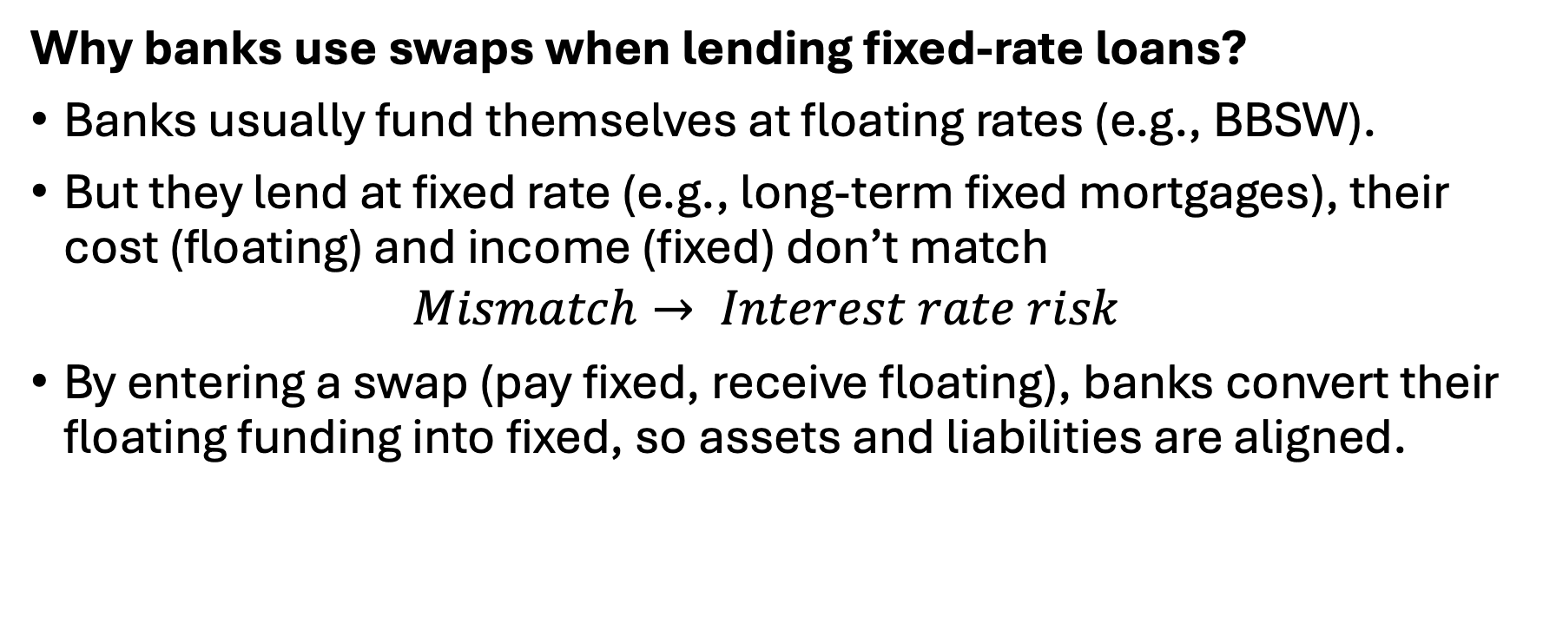
Recap: Bank lending rates
Why banks use swaps when lending fixed-rate loans?
Banks usually fund themselves at floating rates (e.g., BBSW).
But they lend at fixed rate (e.g., long-term fixed mortgages), their cost (floating) and income (fixed) don’t match
$$Mismatch→ Interest rate risk$$
By entering a swap (pay fixed, receive floating), banks convert their floating funding into fixed, so assets and liabilities are aligned.
Notes:
We have just seen how an individual firm can transform its assets or liabilities.
Now let’s apply exactly the same thinking to a bank.
If BBSW rises significantly, the bank's funding cost increases while the income on the fixed loan does not.

Slide 25
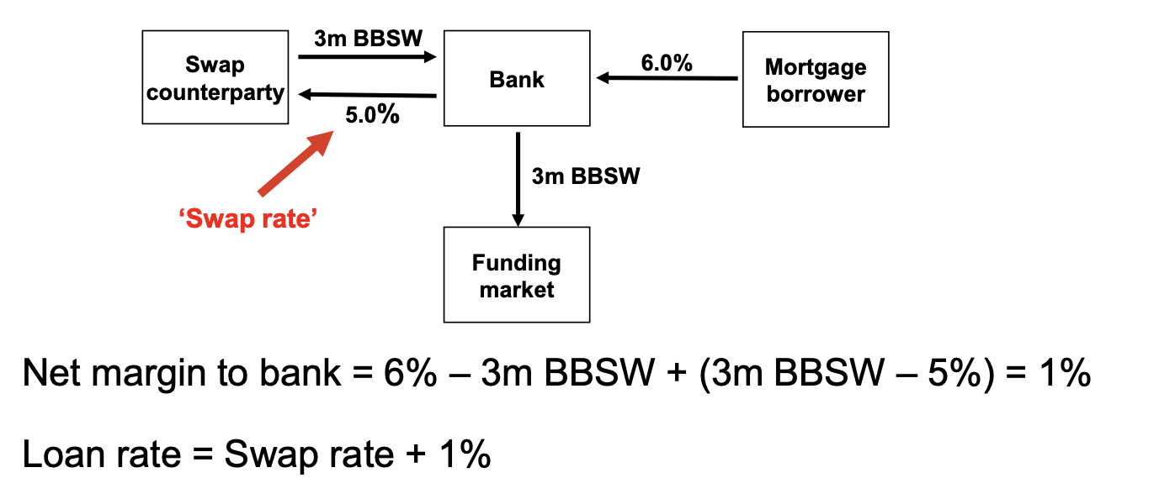

Recap: Bank lending rates
$$Net margin=6\%−3m BBSW$$
Notes:
This diagram shows the mechanics.
Now the bank enters a swap.

Slide 26
Problem 7.16
A bank finds that its assets are not matched with its liabilities. It is taking floating-rate deposits and making fixed-rate loans. How can swaps be used to offset the risk?
Notes:
What is the risk?
If floating rates rise, the cost of the deposits increases, but the income from the fixed loans stays unchanged.

Slide 27
Answer 7.16
The bank is paying a floating-rate on the deposits and receiving a fixed-rate on the loans.
It can offset its risk by entering into interest rate swaps (with other financial institutions or corporations) in which it contracts to pay fixed and receive floating.

Slide 28
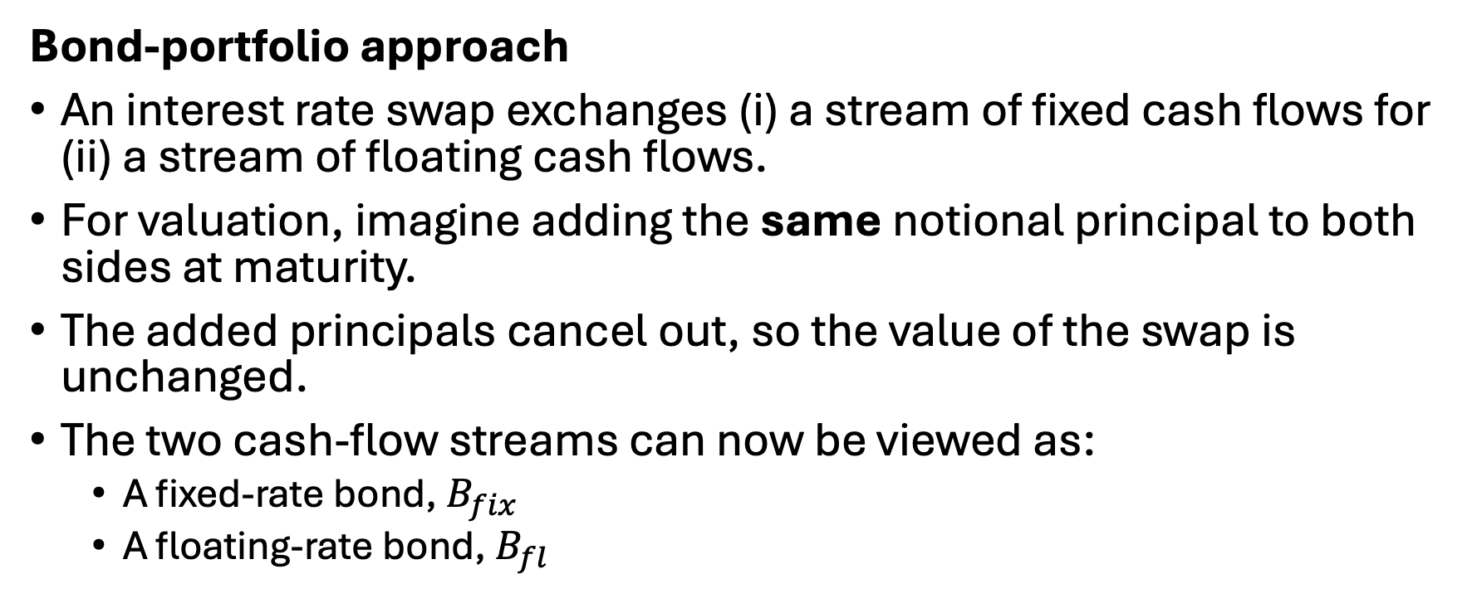
Recap: Valuation of interest rate swaps
Bond-portfolio approach
An interest rate swap exchanges (i) a stream of fixed cash flows for (ii) a stream of floating cash flows.
For valuation, imagine adding the same notional principal to both sides at maturity.
The added principals cancel out, so the value of the swap is unchanged.
The two cash-flow streams can now be viewed as:
  A fixed-rate bond, $B_{fix}$​
  A floating-rate bond, $B_{fl}$
Swap valuation becomes bond valuation!
Notes:
The part now moves from using swaps to valuing an existing swap, using the bond-portfolio approach.
What is that swap worth today?
Does that change the value of the swap?
But doing this gives us a very useful interpretation.

Slide 29
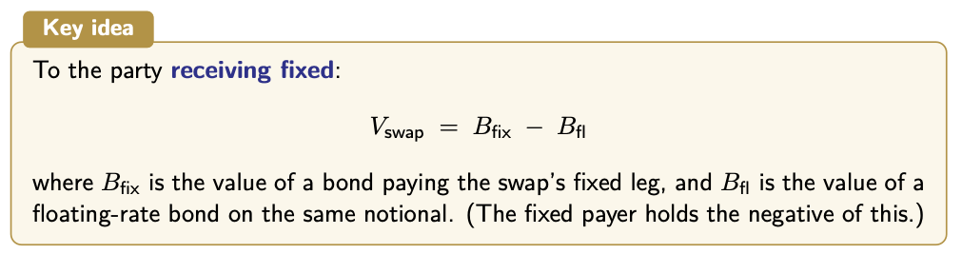

Recap: Valuation of interest rate swaps
For the party paying fixed:
$${V_{swap}=B_{fl}−B}_{fix}$$
Because a swap is a contract between two parties, the values must always be equal and opposite.
Notes:
Once we see the two legs as bonds, the valuation formula becomes very simple.

Slide 30
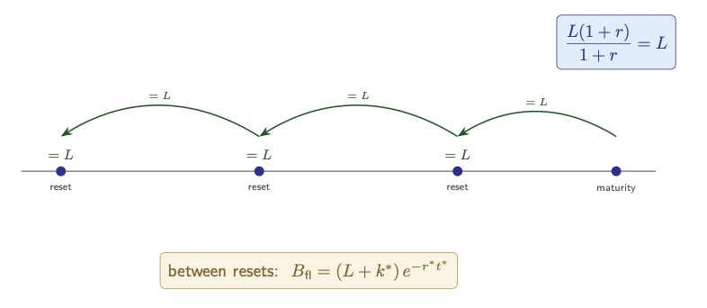


Recap: Valuation of interest rate swaps
Shortcut for $B_{fl}$: The floating-rate resets to par!
1. At each reset date, immediately after the payment, the floating-rate bond is worth par:
$$B_{fl}=L$$
2. Between reset dates, the next floating
payment $(k^{∗})$ is already known because it was fixed at the previous reset date.
3. Therefore, discount the next known payment $(k^{∗})$ + par value $(L)$ back to today.
Notes:
The floating-rate bond has an extremely useful shortcut.
The floating coupon for the next period is reset to the current market rate.
That is why we can write, under the continuous-compounding setup shown here,

Slide 31
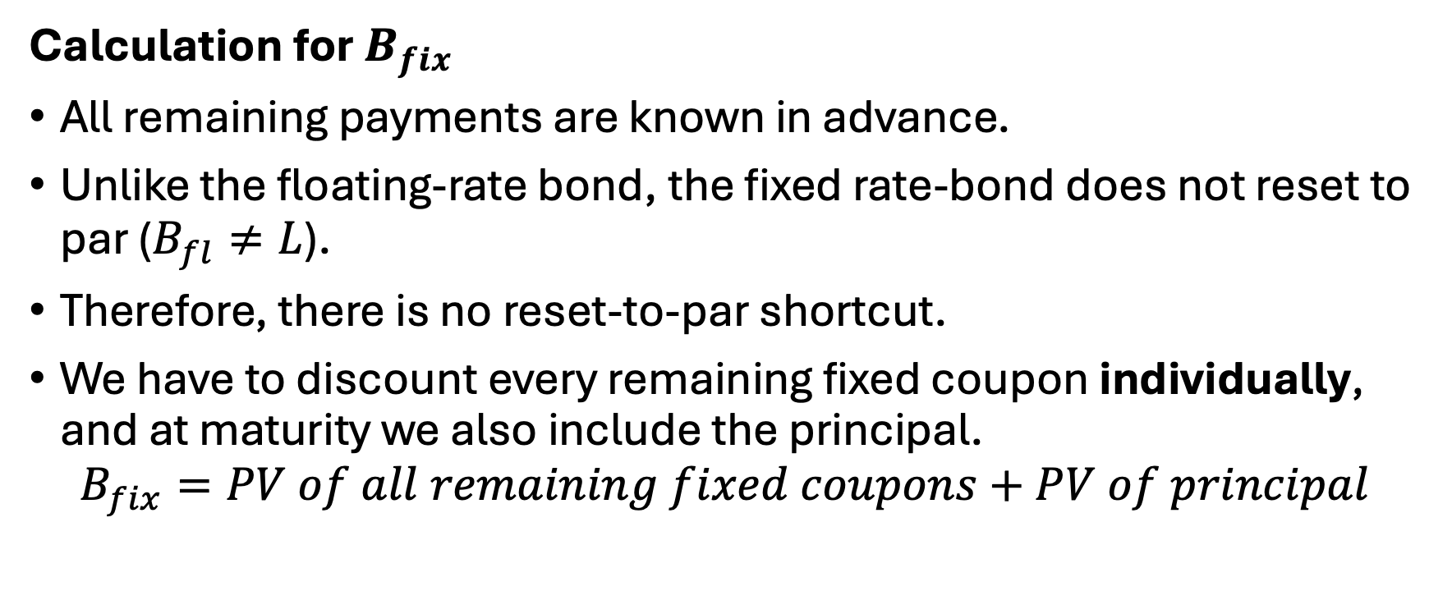
Recap: Valuation of interest rate swaps
Calculation for $B_{fix}$
All remaining payments are known in advance.
Unlike the floating-rate bond, the fixed rate-bond does not reset to par ($B_{fl}≠L$).
Therefore, there is no reset-to-par shortcut.
We have to discount every remaining fixed coupon individually, and at maturity we also include the principal.
$$B_{fix}=PV of all remaining fixed coupons+PV of principal$$
Notes:
The fixed-rate bond is different.

Slide 32



Recap: Valuation of interest rate swaps
Today
$$B_{fix}=?$$
Fixed Coupon 2 + Principal
Fixed Coupon 1
Inception
t1
Maturity
$$B_{fix}=\left(L+k^{∗}\right)e^{−rt}=?$$
Floating payment 1
$$V_{swap}=B_{fl}−B_{fix}=?$$
Notes:
If you prefer not to use the shortcut, you can simply treat this floating
Either method works – they both give you the same answer.
You can choose whichever one you prefer.

Slide 33
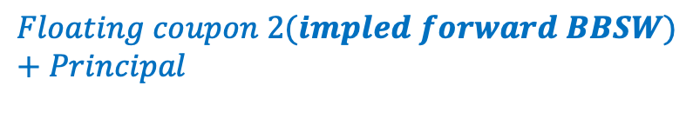
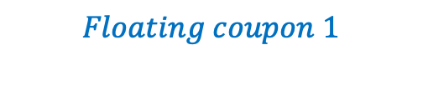
Recap: Valuation of interest rate swaps
Today
$$B_{fix}=?$$
Fixed Coupon 2 + Principal
Fixed Coupon 1
Inception
t1
Maturity
$$B_{fix}=\left(L+k^{∗}\right)e^{−rt}=?$$
$$Floating coupon 1$$
$$Floating coupon 2(impled forward BBSW)+Principal$$
Notes:
If you prefer not to use the shortcut, you can simply treat this floating
Either method works – they both give you the same answer.
You can choose whichever one you prefer.

Slide 34
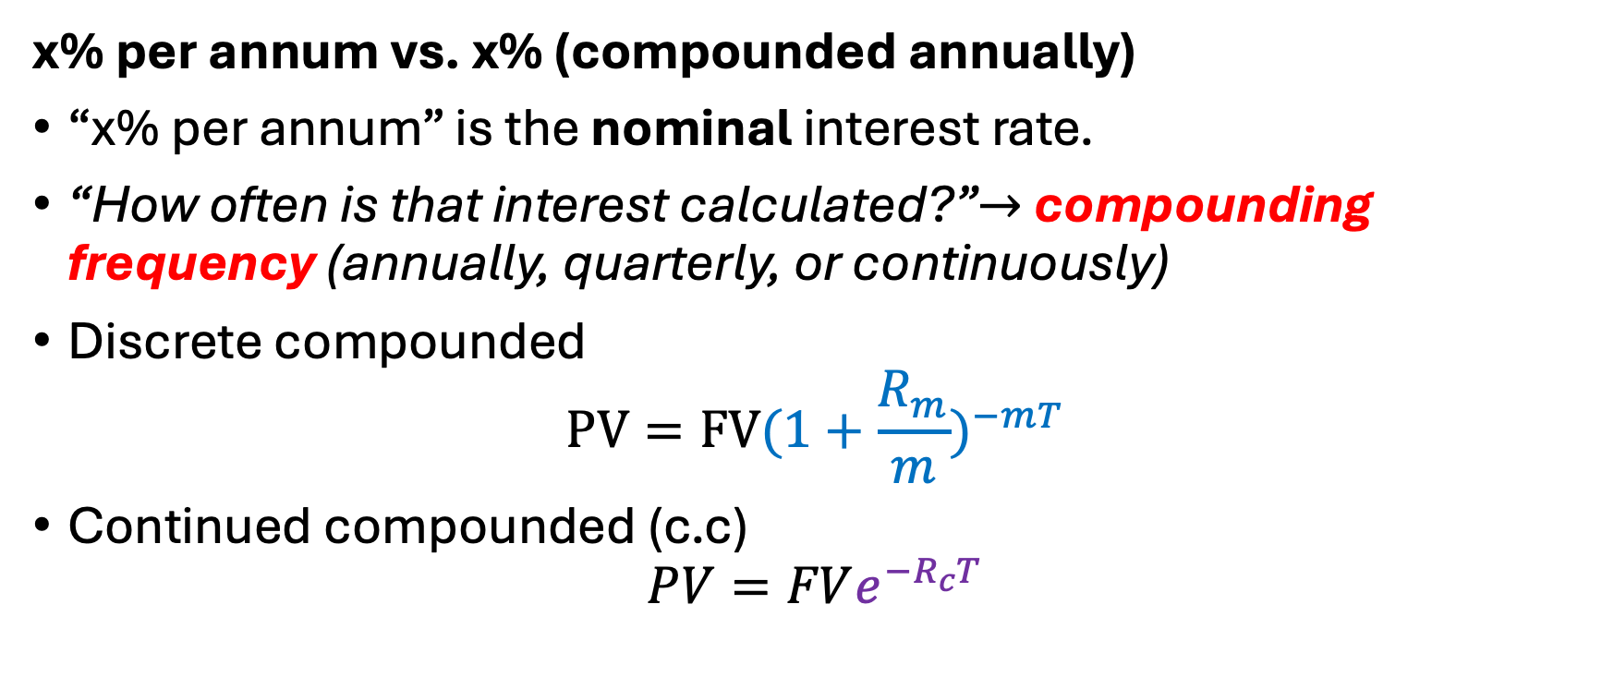

Recap: Valuation of interest rate swaps
x% per annum vs. x% (compounded annually)
“x% per annum” is the nominal interest rate.
“How often is that interest calculated?”$→$ compounding frequency (annually, quarterly, or continuously)
Discrete compounded
$$PV=FV(1+\frac{R_{m}}{m})^{−mT}$$
Continued compounded (c.c)
$$PV=FVe^{−R_{c}T}$$
$$x\% \left(c.c\right) ↔y\% (discrete)$$
Notes:
Per annum simply means “for the year”.
If you are dealing with regular intervals, like monthly, quarterly, or semi-annually, you will use the first formula.
If the problem is related to an infinite number of times, you will use the second formula involving e.
By setting the two formulas equal to each other, you can always find an equivalent rate between them.

Slide 35
Problem 7.2
A $100 million interest rate swap has a remaining life of 10 months. Under the terms of the swap, six-month BBSW is exchanged for 7% per annum (compounded semi-annually). The average of the bid-offer rates being exchanged for six-month BBSW in swaps of all maturities is currently 5% per annum with continuous compounding. The six-monthly BBSW rate was 4.6% per annum two months ago.
What is the current value of the swap to the party paying floating? What is its value to the party paying fixed?
Notes:
How do we find the number of payment dates and when the next one is?
What is the exact cash flow amount for the fixed payment of the swap?

Slide 36
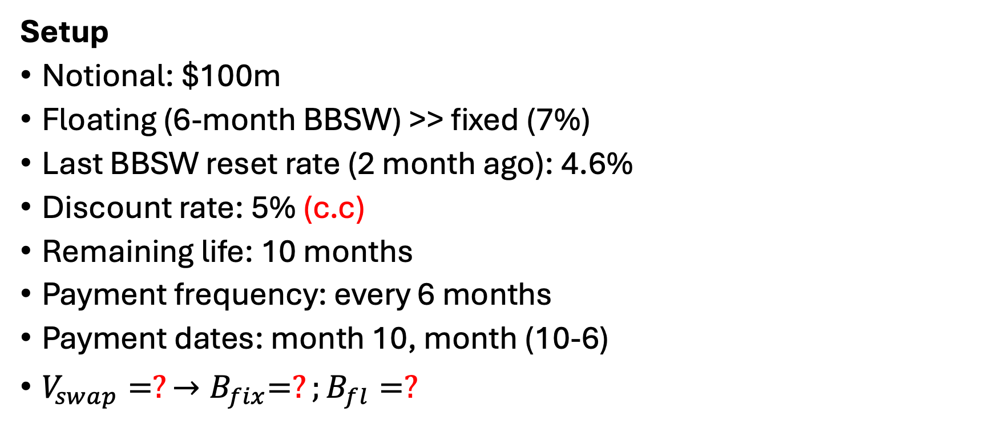

Problem 7.2
Setup
Notional: $100m
Floating (6-month BBSW) >> fixed (7%)
Last BBSW reset rate (2 month ago): 4.6%
Discount rate: 5% (c.c)
Remaining life: 10 months
Payment frequency: every 6 months
Payment dates: month 10, month (10-6)
$V_{swap}=?{→B}_{fix}=?;B_{fl}=?$
$$→PV=FVe^{−5\%T}$$
Discount factor with continuous compounding
Notes:
Let’s organise the information before calculating anything.

Slide 37

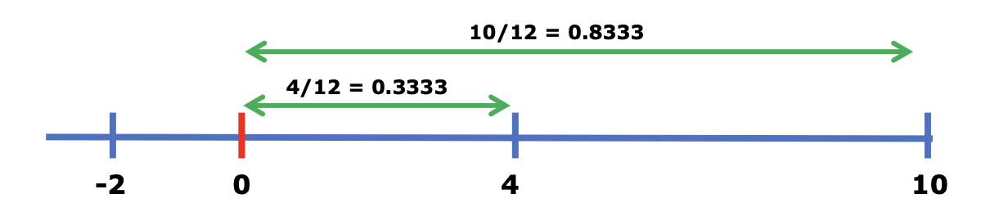
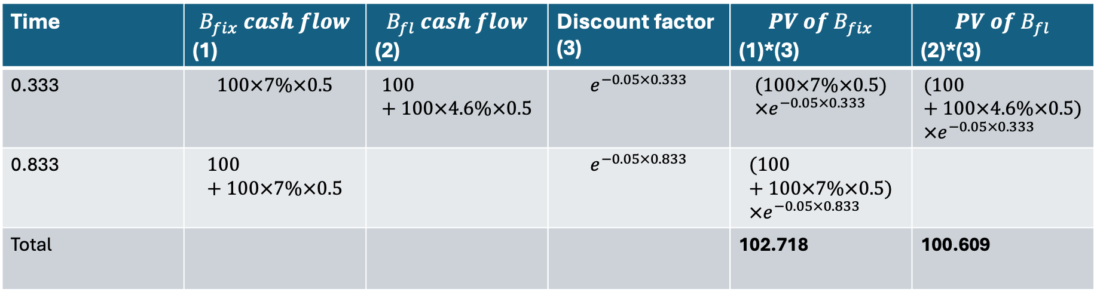
Answer 7.2
Floating rate shortcut version
Time | $$B_{fix} cash flow$$ (1) | $$B_{fl} cash flow$$ (2) | Discount factor (3) | $${PV of B}_{fix}$$ (1)*(3) | $${PV of B}_{fl}$$ (2)*(3)
0.333 | $$100×7\%×0.5$$ | $$100+100×4.6\%×0.5$$ | $$e^{−0.05×0.333}$$ | $$(100×7\%×0.5)×e^{−0.05×0.333}$$ | $$(100+100×4.6\%×0.5)×e^{−0.05×0.333}$$
0.833 | $$100+100×7\%×0.5$$ |  | $$e^{−0.05×0.833}$$ | $$(100+100×7\%×0.5)×e^{−0.05×0.833}$$
Total |  |  |  | 102.718 | 100.609
N/A

Slide 38
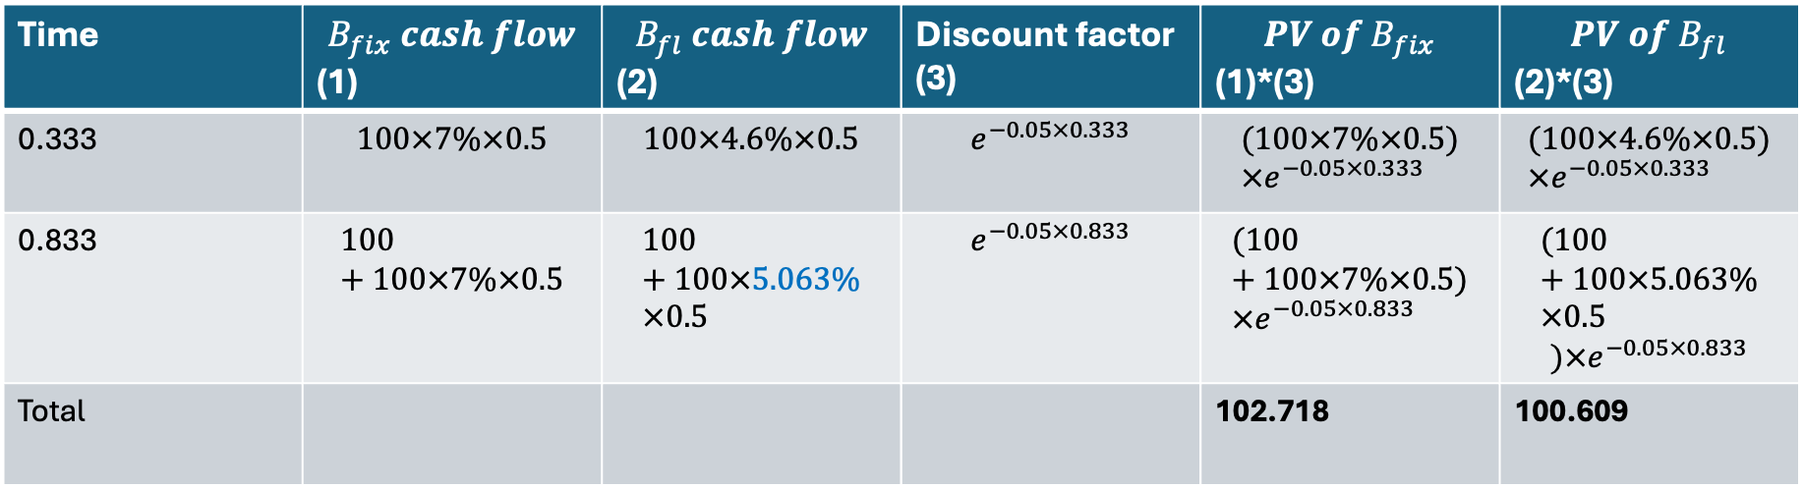


Answer 7.2
$zero curve \left(flat 5\%\right)→Implied 6−month forward BBSW→(1+\frac{R_{m}}{m})^{mT}=e^{R_{c}T}→1+\frac{R_{2}}{2}=\frac{e^{0.05×0.833}}{e^{0.05×0.333}}=e^{0.05×0.5}→R_{2}=5.063\%$
$$5\% \left(c.c\right) ↔5.063\% (s.a)$$
Time | $$B_{fix} cash flow$$ (1) | $$B_{fl} cash flow$$ (2) | Discount factor (3) | $${PV of B}_{fix}$$ (1)*(3) | $${PV of B}_{fl}$$ (2)*(3)
0.333 | $$100×7\%×0.5$$ | $$100×4.6\%×0.5$$ | $$e^{−0.05×0.333}$$ | $$(100×7\%×0.5)×e^{−0.05×0.333}$$ | $$(100×4.6\%×0.5)×e^{−0.05×0.333}$$
0.833 | $$100+100×7\%×0.5$$ | $$100+100×5.063\%×0.5$$ | $$e^{−0.05×0.833}$$ | $$(100+100×7\%×0.5)×e^{−0.05×0.833}$$ | $$(100+100×5.063\%×0.5$$ $$)×e^{−0.05×0.833}$$
Total |  |  |  | 102.718 | 100.609

Slide 39

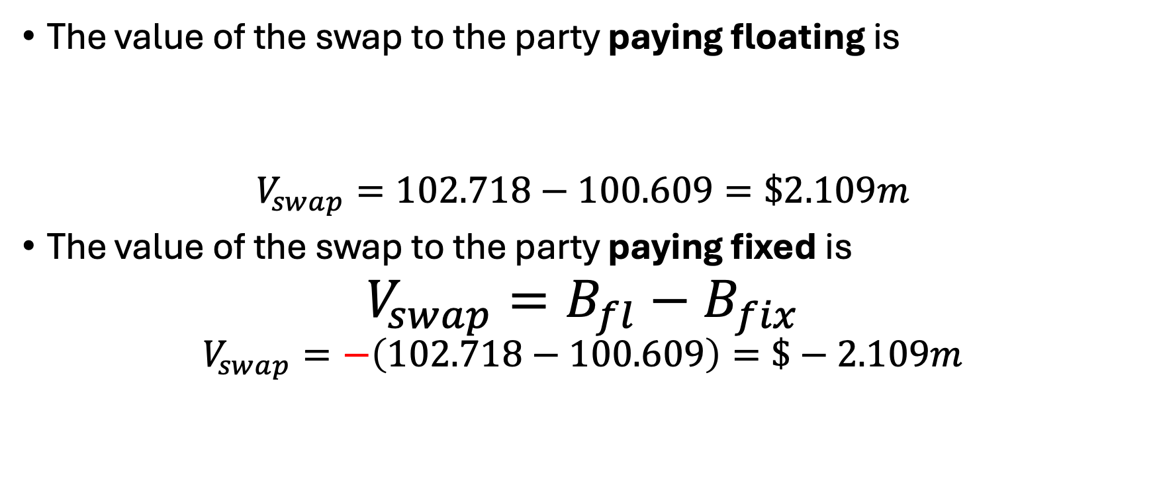
Answer 7.2
The value of the swap to the party paying floating is
$$V_{swap}=102.718−100.609=\$2.109m$$
The value of the swap to the party paying fixed is
$${V_{swap}=B_{fl}−B}_{fix}$$
$$V_{swap}=−\left(102.718−100.609\right)=\$−2.109m$$

Slide 40
Problem 7.23
In an interest rate swap, a financial institution pays 10% per annum and receives three-month BBSW in return on a notional principal of $100 million with payments being exchanged every three months. The swap has a remaining life of 14 months. The average of the bid and offer fixed rates currently being swapped for three-month BBSW is 12% per annum for all maturities. The three-month BBSW rate one month ago was 11.8% per annum. All rates are compounded quarterly.
What is the value of the swap?
Notes:
At the time of default, the swap had a positive market value to the financial institution. However, because Company X defaulted, this positive value could not be realized.
The tricky part here is the discount rate. You must pay close attention to the compounding frequency, as it determines whether you should use a discrete or continuous compounding formula.

Slide 41
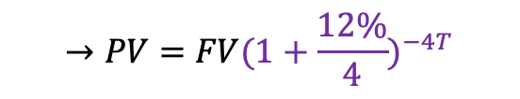
Answer 7.23
Setup
Notional: $100m
Fixed (10%) >> Floating (three-month BBSW)
Last BBSW reset rate (1 month ago): 11.8%
Discount rate: 12% (quarterly compounded!)
Remaining life: 14 months
Payment dates: month 14, month (14-3), month (14-3-3), month (14-3-3-3), month (14-3-3-3-3).
Discount factor with discrete compounding
$$→PV=FV(1+\frac{12\%}{4})^{−4T}$$
Notes:
Let’s organise the problem.

Slide 42
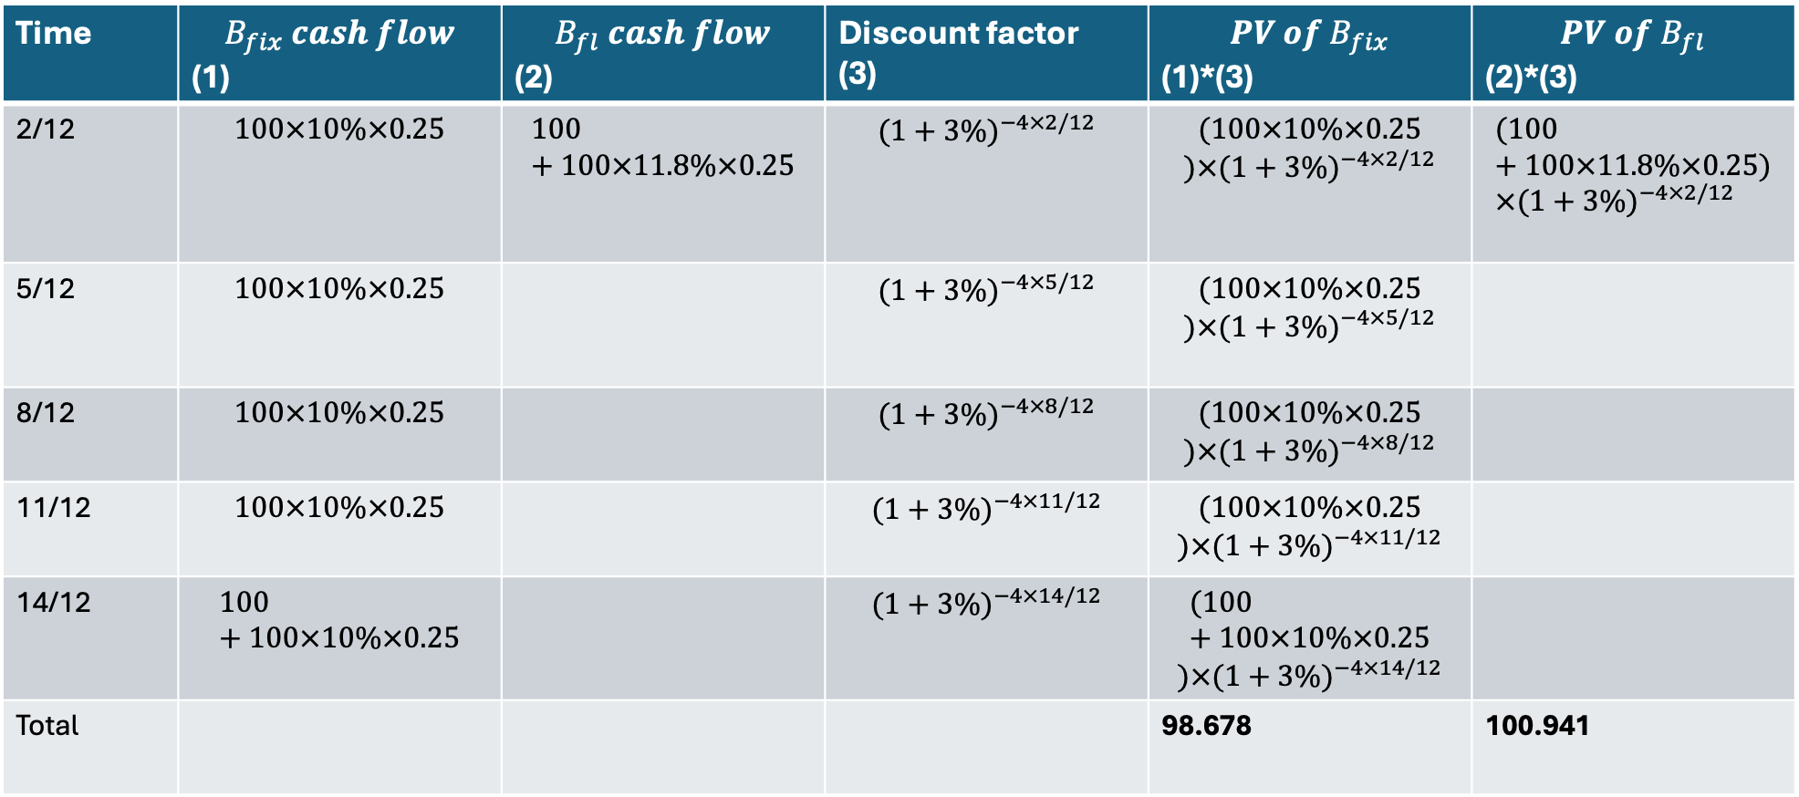
Time | $$B_{fix} cash flow$$ (1) | $$B_{fl} cash flow$$ (2) | Discount factor (3) | $${PV of B}_{fix}$$ (1)*(3) | $${PV of B}_{fl}$$ (2)*(3)
2/12 | $$100×10\%×0.25$$ | $$100+100×11.8\%×0.25$$ | $$(1+3\%)^{−4×2/12}$$ | $$(100×10\%×0.25$$ $$)×(1+3\%)^{−4×2/12}$$ | $$(100+100×11.8\%×0.25)×(1+3\%)^{−4×2/12}$$
5/12 | $$100×10\%×0.25$$ |  | $$(1+3\%)^{−4×5/12}$$ | $$(100×10\%×0.25$$ $$)×(1+3\%)^{−4×5/12}$$
8/12 | $$100×10\%×0.25$$ |  | $$(1+3\%)^{−4×8/12}$$ | $$(100×10\%×0.25$$ $$)×(1+3\%)^{−4×8/12}$$
11/12 | $$100×10\%×0.25$$ |  | $$(1+3\%)^{−4×11/12}$$ | $$(100×10\%×0.25$$ $$)×(1+3\%)^{−4×11/12}$$
14/12 | $$100+100×10\%×0.25$$ |  | $$(1+3\%)^{−4×14/12}$$ | $$(100+100×10\%×0.25$$ $$)×(1+3\%)^{−4×14/12}$$
Total |  |  |  | 98.678 | 100.941
N/A
Discrete compounding: $PV=FV(1+\frac{R_{m}}{m})^{−mT}→m=4, discount factor=(1+\frac{12\%}{4})^{−4T}$

Slide 43
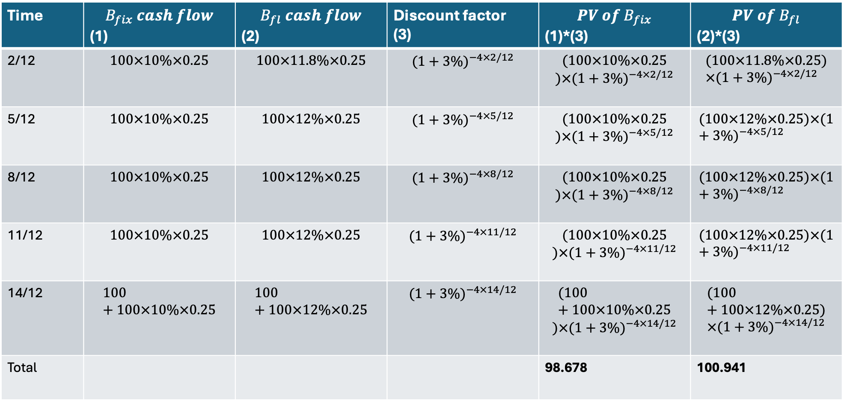
Time | $$B_{fix} cash flow$$ (1) | $$B_{fl} cash flow$$ (2) | Discount factor (3) | $${PV of B}_{fix}$$ (1)*(3) | $${PV of B}_{fl}$$ (2)*(3)
2/12 | $$100×10\%×0.25$$ | $$100×11.8\%×0.25$$ | $$(1+3\%)^{−4×2/12}$$ | $$(100×10\%×0.25$$ $$)×(1+3\%)^{−4×2/12}$$ | $$(100×11.8\%×0.25)×(1+3\%)^{−4×2/12}$$
5/12 | $$100×10\%×0.25$$ | $$100×12\%×0.25$$ | $$(1+3\%)^{−4×5/12}$$ | $$(100×10\%×0.25$$ $$)×(1+3\%)^{−4×5/12}$$ | $$(100×12\%×0.25)×(1+3\%)^{−4×5/12}$$
8/12 | $$100×10\%×0.25$$ | $$100×12\%×0.25$$ | $$(1+3\%)^{−4×8/12}$$ | $$(100×10\%×0.25$$ $$)×(1+3\%)^{−4×8/12}$$ | $$(100×12\%×0.25)×(1+3\%)^{−4×8/12}$$
11/12 | $$100×10\%×0.25$$ | $$100×12\%×0.25$$ | $$(1+3\%)^{−4×11/12}$$ | $$(100×10\%×0.25$$ $$)×(1+3\%)^{−4×11/12}$$ | $$(100×12\%×0.25)×(1+3\%)^{−4×11/12}$$
14/12 | $$100+100×10\%×0.25$$ | $$100+100×12\%×0.25$$ | $$(1+3\%)^{−4×14/12}$$ | $$(100+100×10\%×0.25$$ $$)×(1+3\%)^{−4×14/12}$$ | $$(100+100×12\%×0.25)×(1+3\%)^{−4×14/12}$$
Total |  |  |  | 98.678 | 100.941
$$Implied 3−month forward BBSW=12\%$$

Slide 44

Answer 7.23
The value of the swap to the party paying fixed is therefore
$${V_{swap}=B_{fl}−B}_{fix}$$
$$V_{buyer}=100.941−98.678=\$2.263m$$

Slide 45
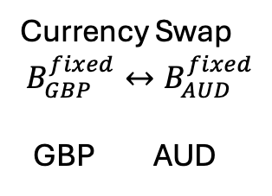
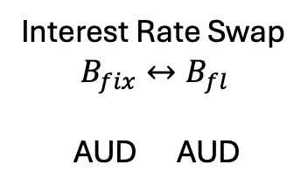
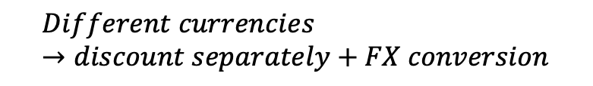
Recap: Valuation of currency swaps
Unlike interest rate swap, the fixed-for-fixed currency swap exchanges cash flows in different currencies;
In an interest rate swap, the principal is only a notional amount and is not exchanged;
In a currency swap, a separate principal amount is specified for each currency and the principals are typically exchanged at inception and re-exchanged at maturity.
Currency Swap
$$B_{GBP}^{fixed}↔B_{AUD}^{fixed}$$
GBP AUD
Interest Rate Swap
$$B_{fix}↔B_{fl}$$
AUD AUD
$$Different currencies→discount separately+FX conversion$$
$$Same currencies→compared directly$$
Notes:
I hand you 20 million British Pounds. You are handing me 30 million Australian Dollars.

Slide 46
Recap: Valuation of currency swaps
For example, imagine an Australian company wants to build a factory in the UK. They need British Pounds to pay the construction workers. However, because they are an Australian company, they can get a much cheaper loan from an Australian bank in AUD.
They will borrow the AUD 30m, enter a currency swap to physically exchange that AUD 30m for GBP 20m today, use the GBP 20m to build their factory, and then swap the principals back at the end of the contract.

Slide 47
Recap: Valuation of currency swaps
Valuation in terms of a bond
We literally have one stream of cash flows in one currency and another stream of cash flows in another currency, including principal repayment.
Treat the cash flows in each currency as a bond;
Discount each bond using the interest rate for that currency;
Convert one bond value into the other currency using the spot exchange rate.

Slide 48
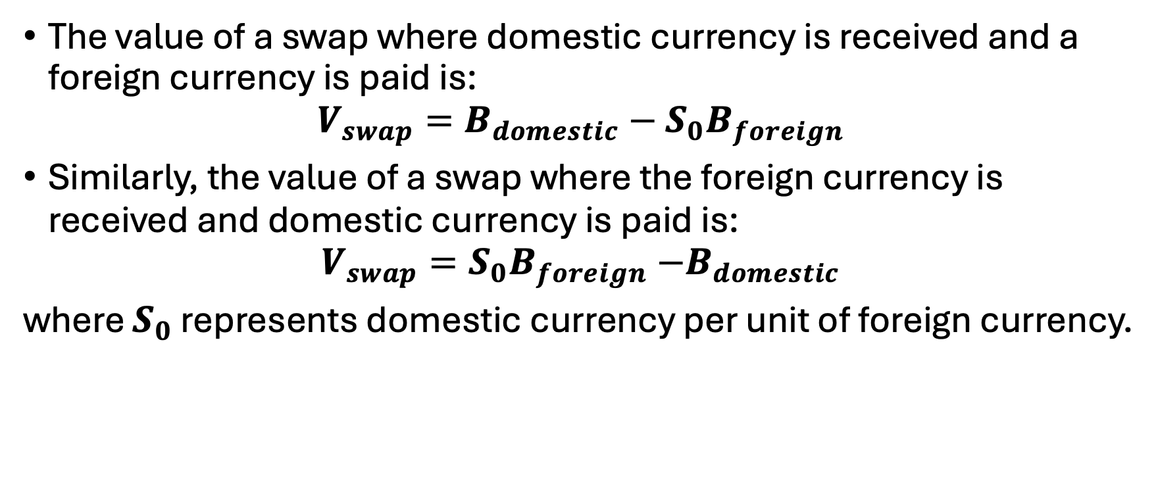
Recap: Valuation of currency swaps
The value of a swap where domestic currency is received and a foreign currency is paid is:
$$V_{swap}=B_{domestic}−S_{0}B_{foreign}$$
Similarly, the value of a swap where the foreign currency is received and domestic currency is paid is:
$$V_{swap}=S_{0}B_{foreign}{−B}_{domestic}$$
where $S_{0}$ represents domestic currency per unit of foreign currency.
Notes:
We can write that idea formally.

Slide 49
Problem 7.5
A currency swap has a remaining life of 15 months. It involves exchanging interest at 10% on GBP20 million for interest at 6% on AUD30 million once a year. The term structure of interest rates in both the United Kingdom and Australia is currently flat and if the swap were negotiated today the interest rates would be 4% in dollars and 7% in sterling. All interest rates are quoted with annual compounding. The current exchange rate (dollars per pound sterling) is 1.8500.
What is the value of the swap to the party paying sterling? What is the value of the swap to the party paying dollars?

Slide 50
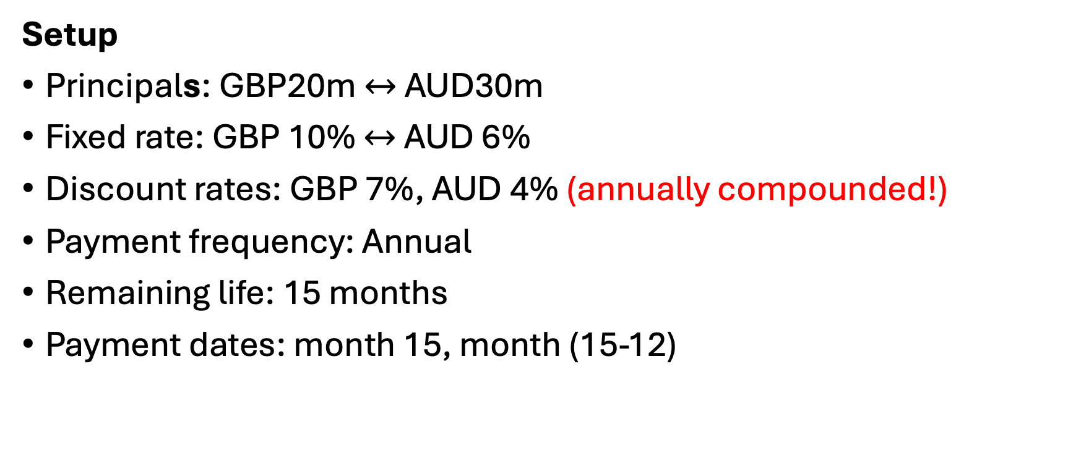
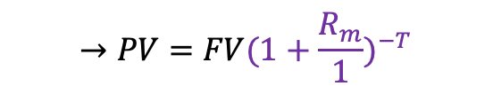
Answer 7.5
Setup
Principals: GBP20m $↔$ AUD30m
Fixed rate: GBP 10% $↔$ AUD 6%
Discount rates: GBP 7%, AUD 4% (annually compounded!)
Payment frequency: Annual
Remaining life: 15 months
Payment dates: month 15, month (15-12)
Discount factor with discrete compounding
$$→PV=FV(1+\frac{R_{m}}{1})^{−T}$$
Notes:
So let’s set everything up before calculating.
3/12 of a year and 15/12 of a year.

Slide 51
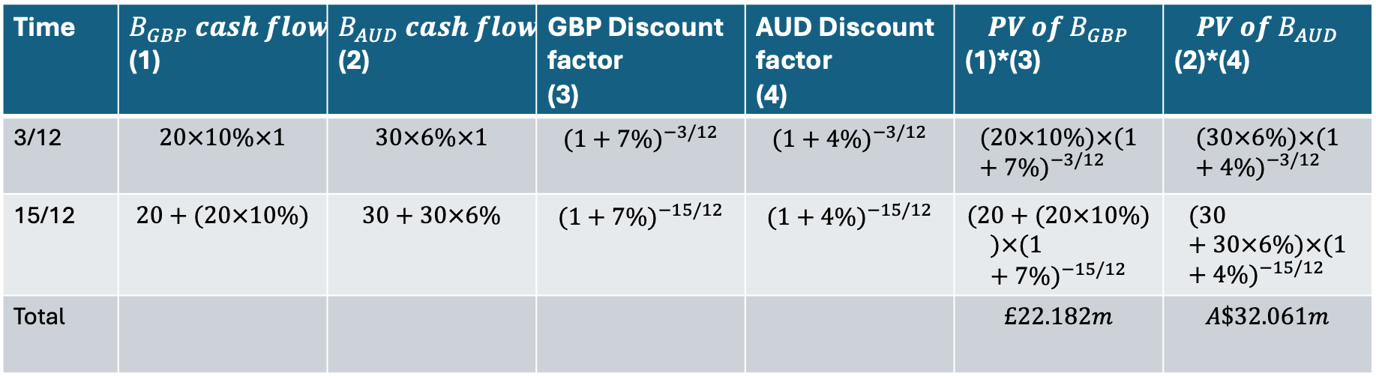

Answer 7.5
Discount each currency separately!
Time | $$B_{GBP} cash flow$$ (1) | $$B_{AUD} cash flow$$ (2) | GBP Discount factor (3) | AUD Discount factor (4) | $${PV of B}_{GBP}$$ (1)*(3) | $${PV of B}_{AUD}$$ (2)*(4)
3/12 | $$20×10\%×1$$ | $$30×6\%×1$$ | $$(1+7\%)^{−3/12}$$ | $$(1+4\%)^{−3/12}$$ | $$(20×10\%)×(1+7\%)^{−3/12}$$ | $$(30×6\%)×(1+4\%)^{−3/12}$$
15/12 | $$20+(20×10\%)$$ | $$30+30×6\%$$ | $$(1+7\%)^{−15/12}$$ | $$(1+4\%)^{−15/12}$$ | $$(20+(20×10\%)$$ $$)×(1+7\%)^{−15/12}$$ | $$(30+30×6\%)×(1+4\%)^{−15/12}$$
Total |  |  |  |  | $$£22.182m$$ | $$A\$32.061m$$
$$£1=A\$1.85$$
GBP: Foreign currency
AUD: Domestic currency
$${GBP payer: V}_{swap}=B_{domestic}−S_{0}B_{foreign}=32.061−22.182×1.85=−\$8.976m$$
$${AUD payer: V}_{swap}=S_{0}B_{foreign}−B_{domestic}=\$8.976m$$

Slide 52
Problem 7.24
For all maturities, the US dollar (USD) interest rate is 7% per annum and the Australian dollar (AUD) rate is 9% per annum. The current value of the AUD is 0.62 USD. In a swap agreement, a financial institution pays 8% per annum in AUD and receives 4% per annum in USD. The principals in the two currencies are USD 12 million and AUD 20 million. Payments are exchanged every year, with one exchange having just taken place. The swap will last two more years.
What is the value of the swap to the financial institution? Assume all interest rates are continuously compounded.
Notes:
The wording “all interest rates are continuously compounded” is slightly loose here; in the textbook solution, it is applied to the market discount rates, not to the contractual coupon payments.

Slide 53
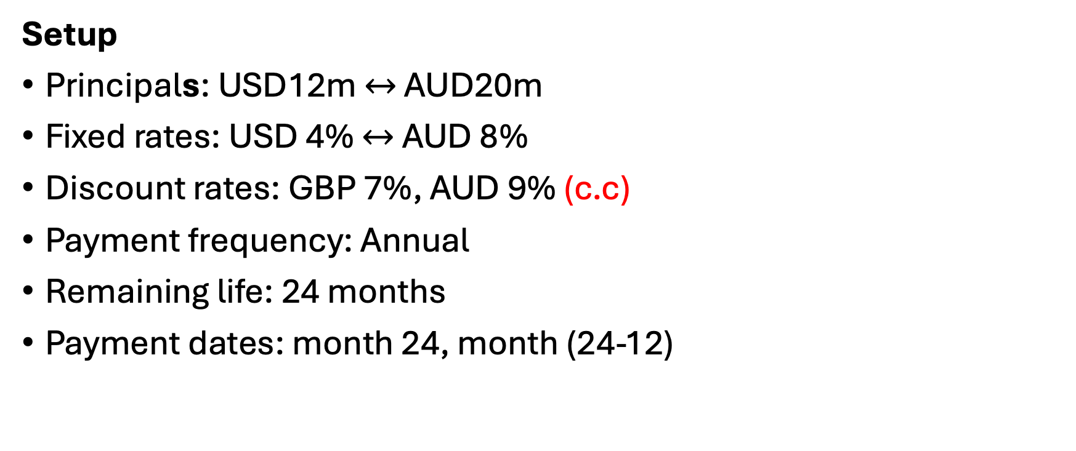
Answer 7.24
Setup
Principals: USD12m $↔$ AUD20m
Fixed rates: USD 4% $↔$ AUD 8%
Discount rates: GBP 7%, AUD 9% (c.c)
Payment frequency: Annual
Remaining life: 24 months
Payment dates: month 24, month (24-12)

Slide 54
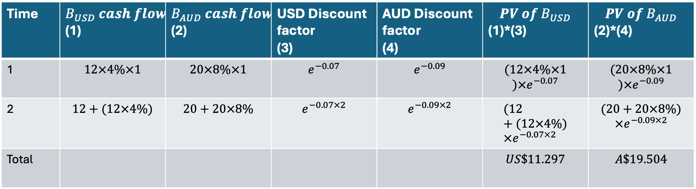

Answer 7.24
Time | $$B_{USD} cash flow$$ (1) | $$B_{AUD} cash flow$$ (2) | USD Discount factor (3) | AUD Discount factor (4) | $${PV of B}_{USD}$$ (1)*(3) | $${PV of B}_{AUD}$$ (2)*(4)
1 | $$12×4\%×1$$ | $$20×8\%×1$$ | $$e^{−0.07}$$ | $$e^{−0.09}$$ | $$(12×4\%×1$$ $$)×e^{−0.07}$$ | $$(20×8\%×1$$ $$)×e^{−0.09}$$
2 | $$12+(12×4\%)$$ | $$20+20×8\%$$ | $$e^{−0.07×2}$$ | $$e^{−0.09×2}$$ | $$(12+(12×4\%)×e^{−0.07×2}$$ | $$(20+20×8\%)$$ $$×e^{−0.09×2}$$
Total |  |  |  |  | $$US\$11.297$$ | $$A\$19.504$$
$$A\$1=US\$0.62$$
AUD: Foreign currency
USD: Domestic currency
$${AUD payer: V}_{swap}=B_{domestic}−S_{0}B_{foreign}=11.297−0.62×19.504=−US\$0.795m$$

